Slide 1
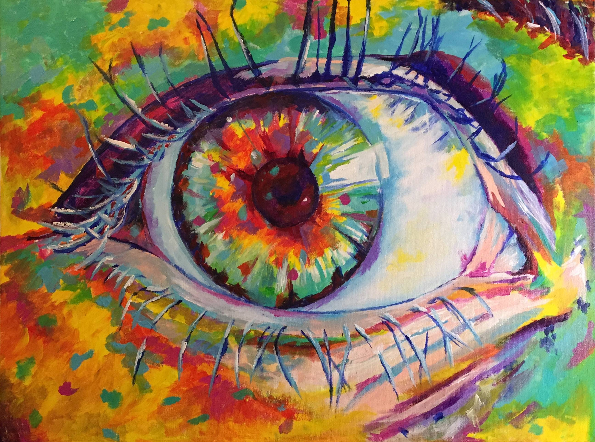


WeART
Discover the authenticity of the masterpieces.

Slide 2

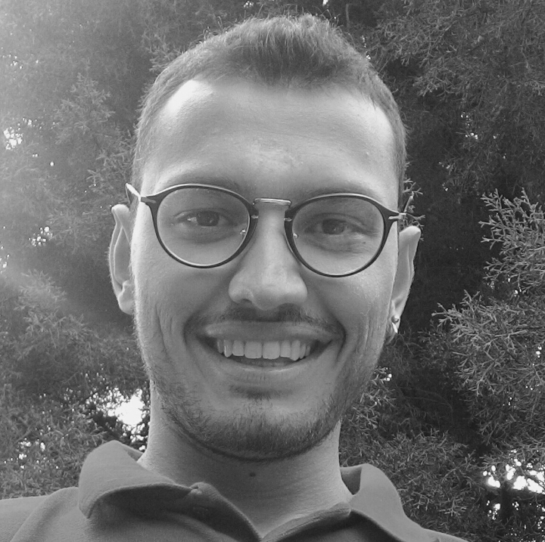
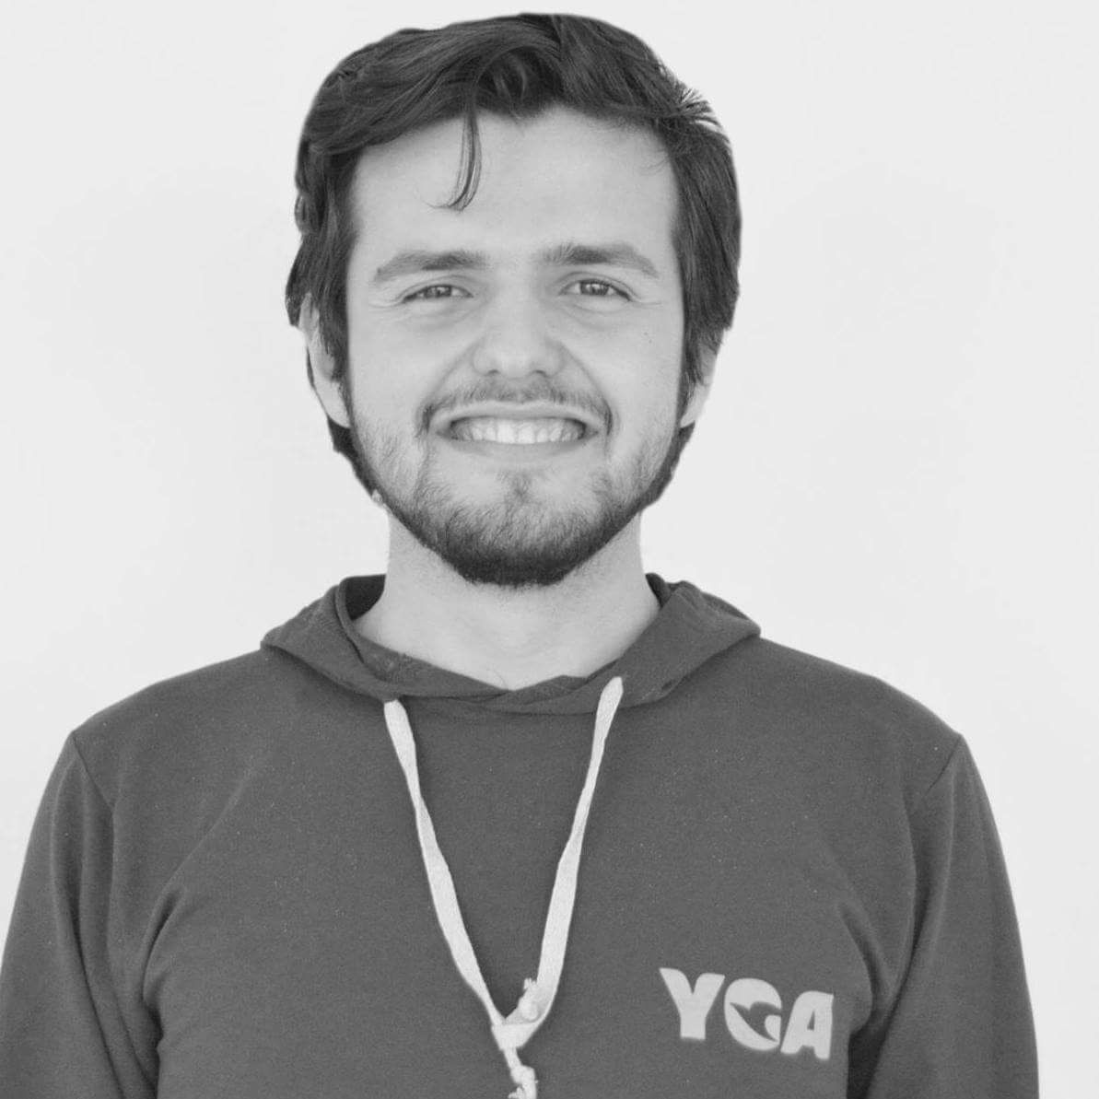
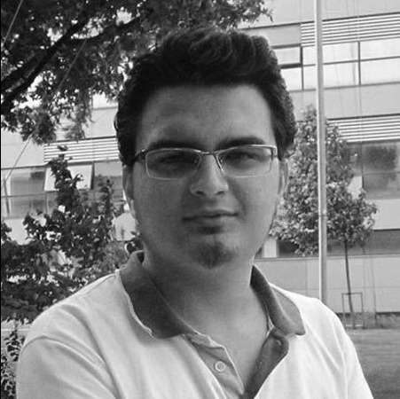

Who we are ?
Burak Onat Bilgiç
Oğulcan Başkan
Mesut Yılmaz
Frontend Developer
Business Developer
Backend Developer

Slide 3
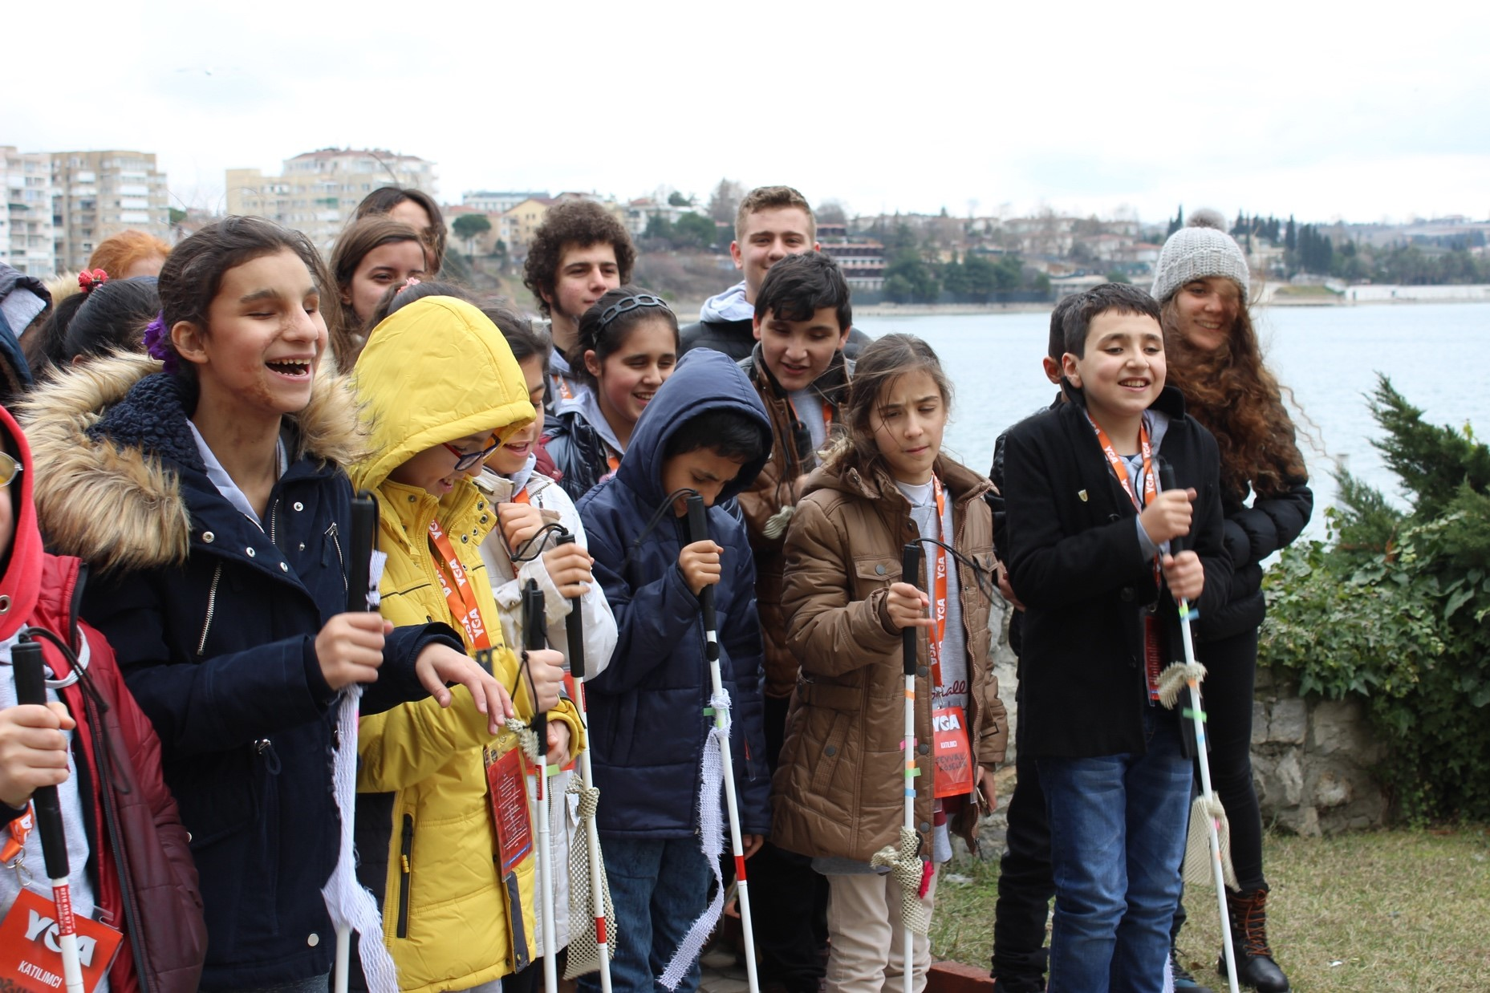
Insight From Field
“ It might be very exciting that experience every details at exhibitions independently.”

Slide 4
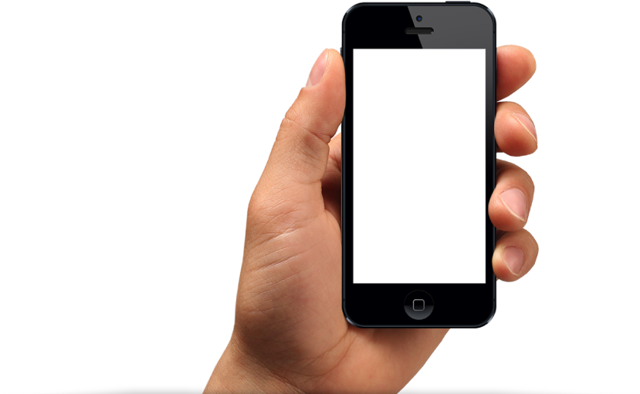
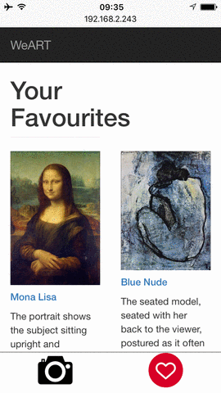
How It Works ?
Visual Recognition
Audio Description
Discover New Artworks

Slide 5
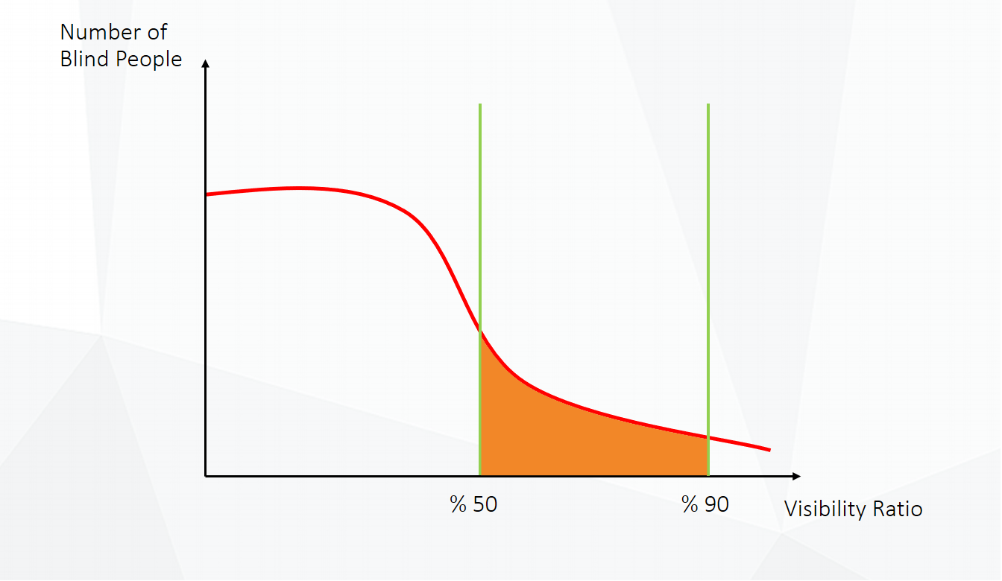
Target Audience
640 K Visually Impaired

Slide 6
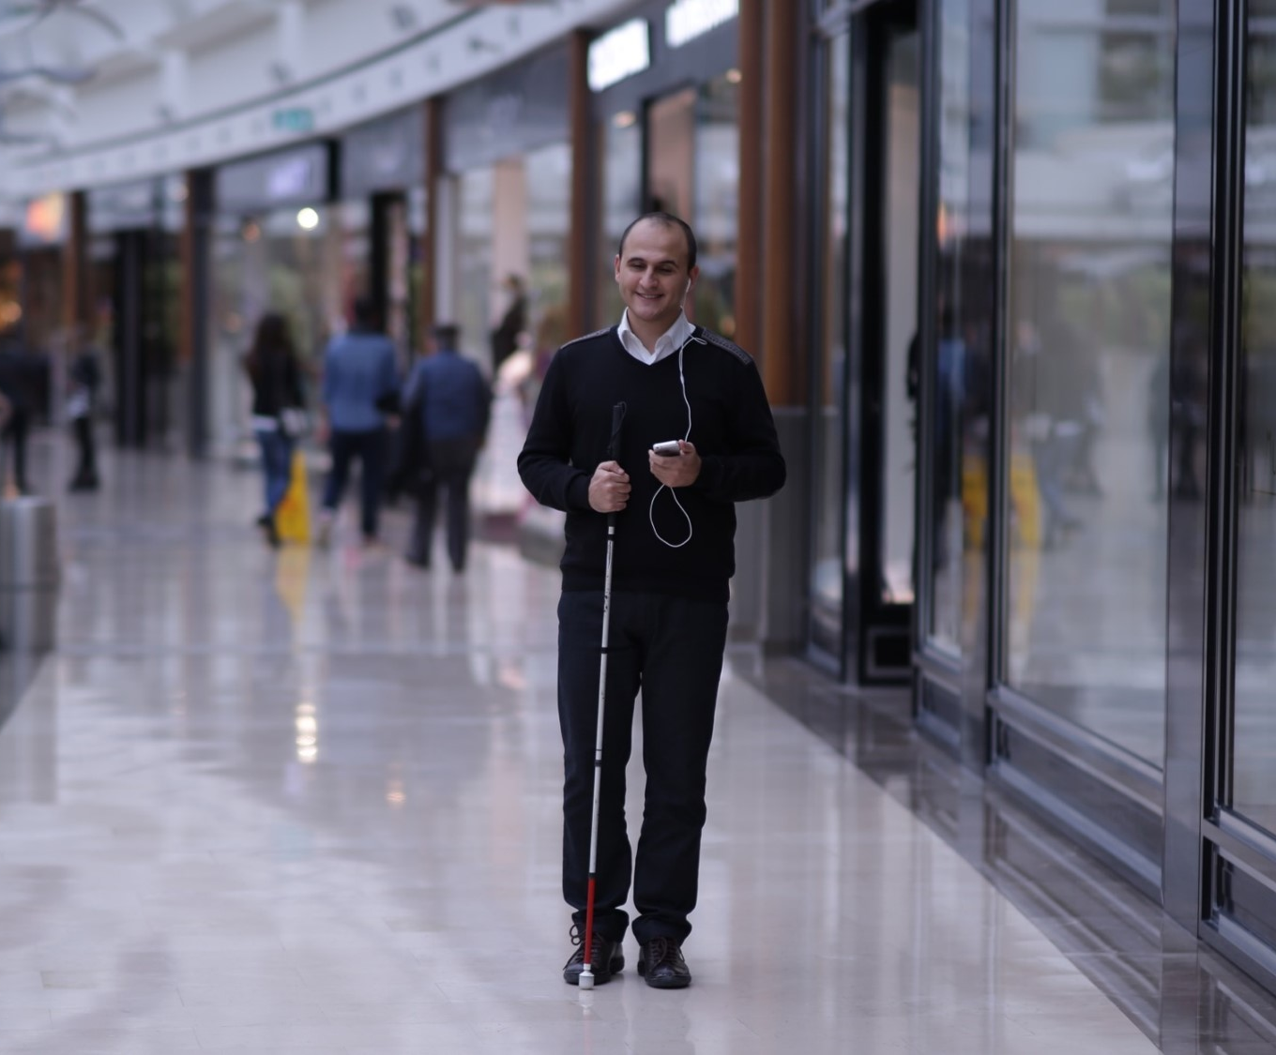
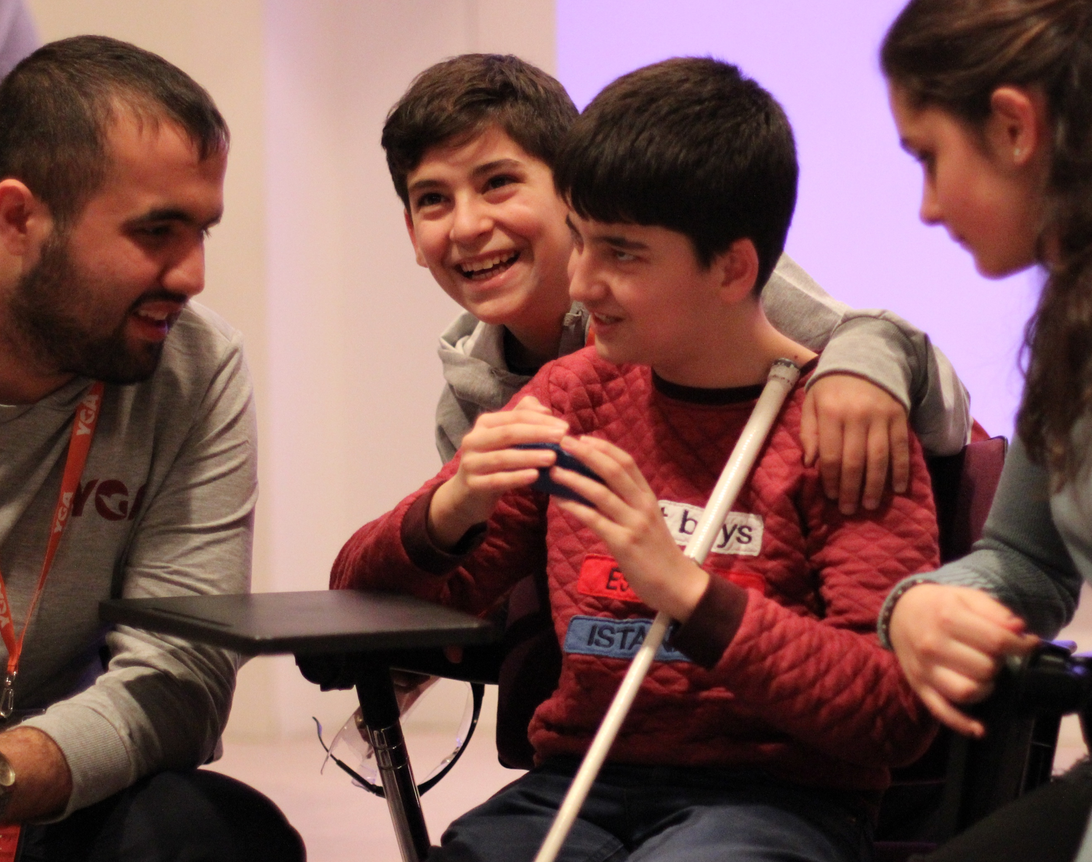
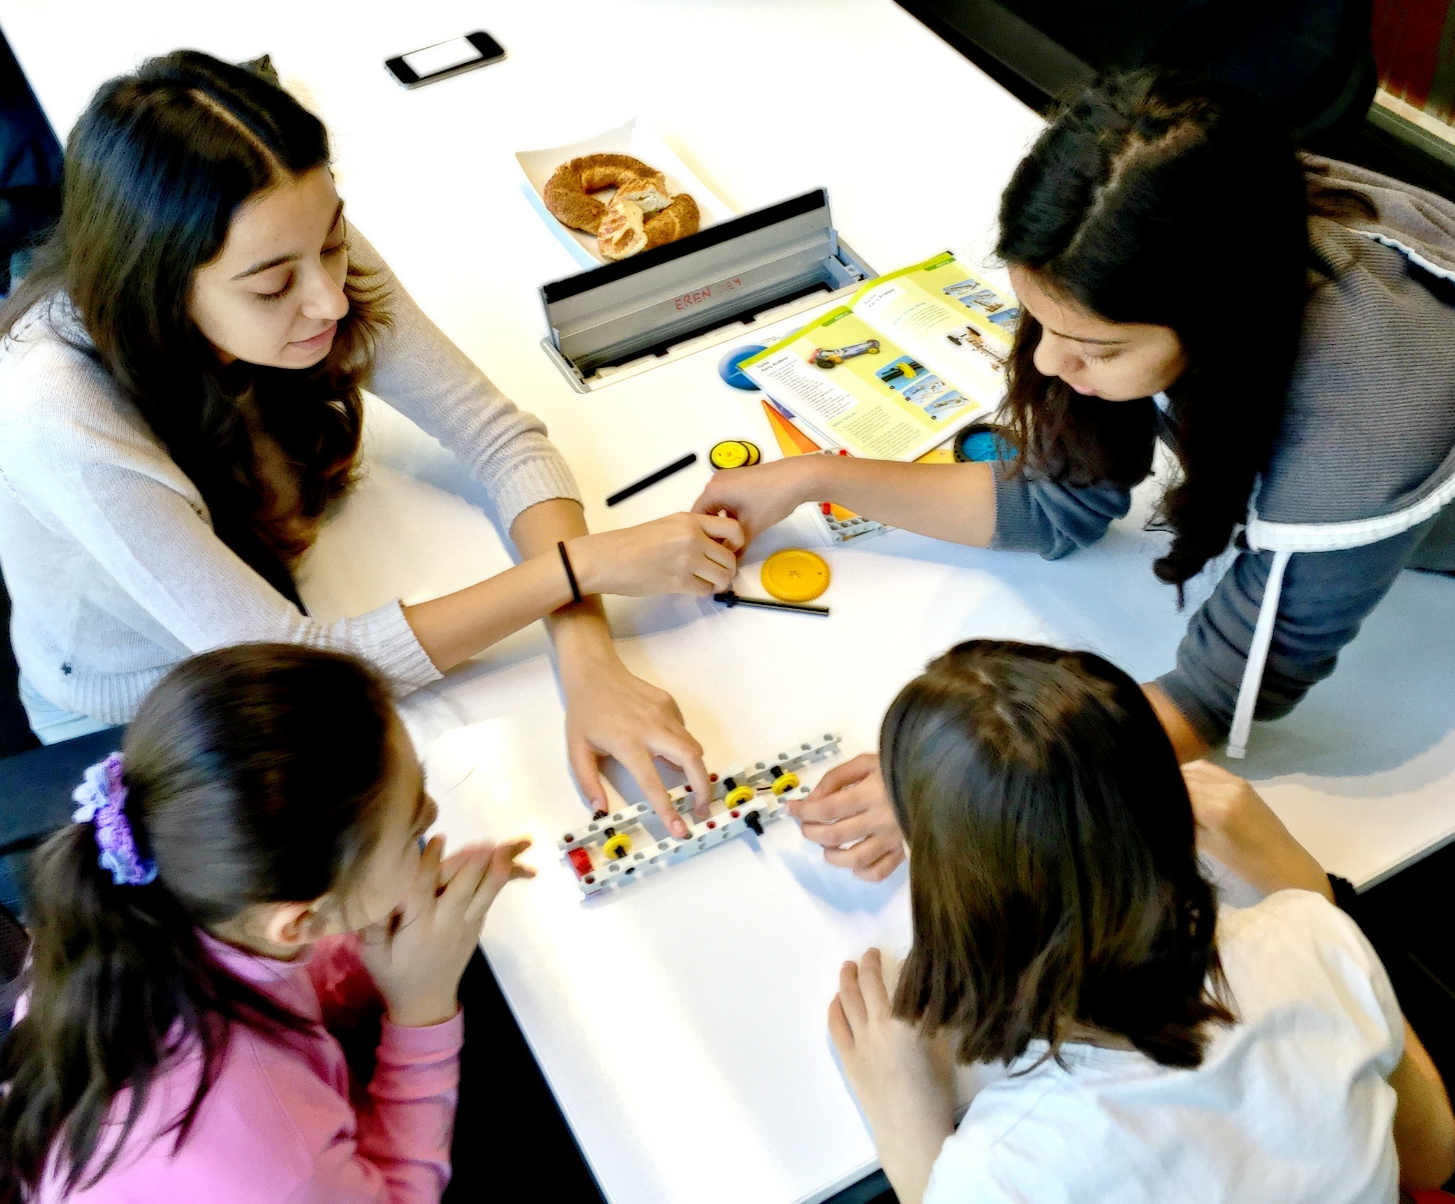
Benefits
Independence
Integration into Social Life
Social Improvement

Slide 7

Funding
Collaborations with Companies
Like Turkcell My Dream Companion
Daily, Monthly and development based funding

Slide 8

More data means better experience.
Biggest Challenge

